Slide 1
Visibility Computations:
Finding the Shortest Route for Motion Planning
COMP 290-072 Presentation
Eric D. Baker
Tuesday 1 December 1998

Slide 2
Motivation
Visibility graph computation has same motivation as other robot motion planning:
  autonomous robots; to move around on their own, they must plan their motion
  target collision-free motion
However, we now not only find a path if on exists, but we find a shortest path

Slide 3
Problem Assumptions
Static environment, single robot
Robot and obstacles are polyhedral
Can touch obstacles; can enlarge robot
Compute free and forbidden spaces in O(n log² n) time as before using Minkowski sums

Slide 4
Characteristics of a shortest path
Any shortest path between p and q among a set S of disjoint polygonal obstacles is a polygonal path whose inner vertices are vertices of S.
useful definitions:
  two vertices v and w are mutually visible if vw does not intersect the interior of any obstacle; two segment vw is a visibility edge.

Slide 5
Approaches to computing visibility
Visibility graph method:
  construct a graph whose nodes are vertices of the obstacles (plus the start and destination) and whose edges are pairs of mutually visible vertices; shortest path then found by running a Dijkstra-type SP algorithm on the resulting graph

Slide 6
Approaches to computing visibility
Shortest path map method:
  build a shortest path map with respect to a fixed point (i.e. desired destination); all points in a region of the map have the same vertex sequence in the shortest path to the destination

Slide 7
Algorithms
Visibility Graph Algorithms
  Lee O(n² log n) *
  Welzl O(n²) *
  Asano, Asano, Guibas, Hershberger, Imai O(n²)
  Ghosh and Mount O(n log n)
* denotes algorithms featured in presentation

Slide 8
Algorithms
Shortest Path Map Algorithms
  Mitchell O(n^{5/3 +} ^{ε}), O(n^{3/2 + ε})
  Hershberger and Suri O(n log² n)*, O(n log n)
Approximations to shortest paths in 3-D
  Lozano-Perez and Wesley
  Papadimitriou
  Choi, Sellen, and Yap *

Slide 9
Lee: rotational plane sweep
Construct a visibility graph, i.e. a road map based on visibility edges
To do this we perform a rotational plane sweep -- much like a weather radar sweep -- around every vertex in S* (obstacle edges and p, q)

Slide 10
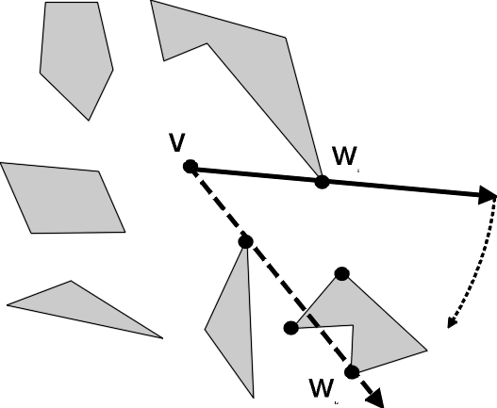
Lee: rotational plane sweep
In the plane sweep, we consider a vertex w visible from v if a ray cast from v in the direction of w doesn’t intersect the interior of an obstacle before reaching w
Ray emanating from v rotating in plane

Slide 11
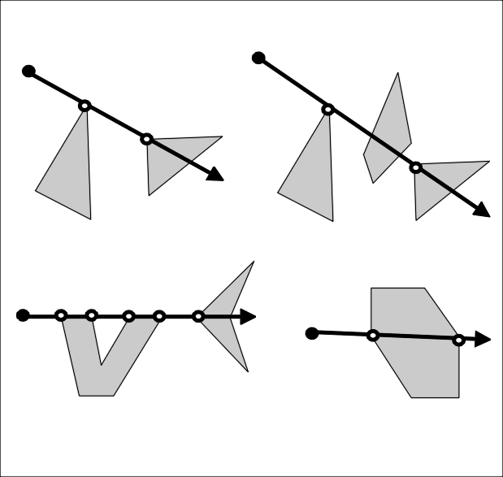
Lee: rotational plane sweep
Finding the visible vertices for each of n vertices takes O(n² log n)
Running Dijkstra’s SP takes O(n log n + k), which is less than computing the vertex visibility
Four cases of sweep ray intersecting multiple vertices

Slide 12
Welzl: arrangement-based approach
Welzl uses arrangements (chapter 8) to compute the endpoint visibility graph for n line segments in O(n²) time
It relies on this: given a line h in an arrangement A, the (at most) n-1 intersections of h with other lines can be sorted along h in linear time from the planar subdivision G(A); better than O(n log n)

Slide 13
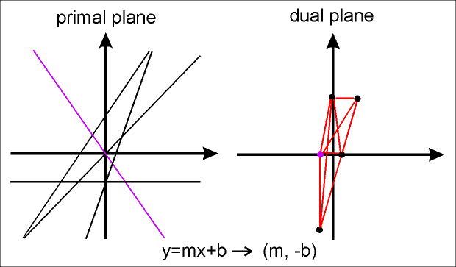
Welzl: arrangement-based approach

Slide 14
Welzl: arrangement-based approach
Visible vertices are again detected by rotating a ray around each vertex, but the ray proceeds in a permuted sequence of angles which leads to an O(n²) time rather than O(n log n)

Slide 15
Hershberger and Suri: subdivisions and waves to compute a shortest path map
Uses quad-tree style subdivision in plane called a conforming subdivision
Also uses a continuous Dijkstra method, which simulates the expansion of a wave front from a single source
Uses a Voronoi diagram method to compute the final shortest path map

Slide 16
Hershberger and Suri: conforming subdivision
Uses a conforming subdivision (a quad-tree style subdivision) of the free space
Each obstacle vertex lies in its own cell and there are O(1) cells within ⏐e ⏐ of any cell edge e
Cell edges are horizontal and vertical

Slide 17
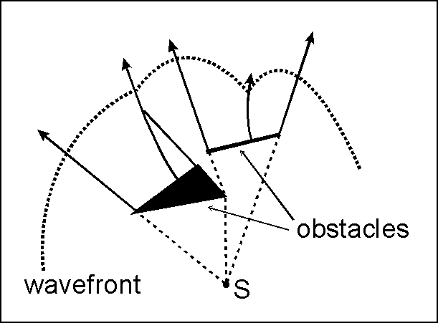
Hershberger and Suri: waves and wavefront propagation
Using the continuous Dijkstra method simulates a wavefront moving outward from our destination S
The wavefront is propagated through transparent (cell) edges, but not through opaque (obstacle) edges

Slide 18
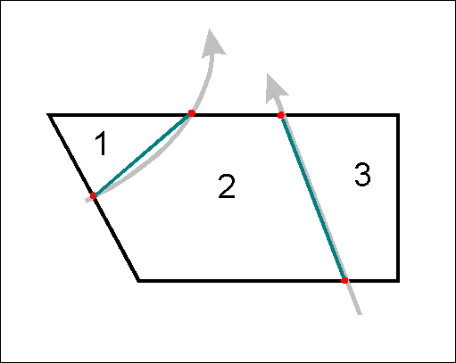
Hershberger and Suri: compute Voronoi diagrams to get shortest path map
Given the arcs and lines that the wavefront trace out -- more precisely where those bisectors intersect cell boundaries -- the shortest path map can be computed both per cell and overall in O(n log n) time
Intersections of bisectors and cell boundaries are marked for Voronoi computation

Slide 19
Choi, Sellen, and Yap: approximate shortest path in 3-space
Based on Papadimitriou’s algorithm; authors filled in gaps and revised
Scheme make approximations by splitting edges and creating grids between edges
Polynomial in bits of precision required and the number of break points into each obstacle edge is split

Slide 20
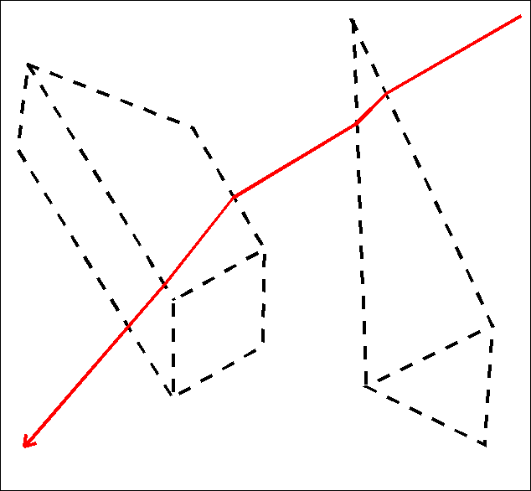
Choi, Sellen, and Yap: approximate shortest path in 3-space

Slide 21
Conclusions
Optimal algorithms have been found for visibility computations in the plane
Finding a shortest path in 3-space among polyhedral objects is NP-hard; a single-exponential algorithms has been given
Polynomial-time algorithms which approximate the shortest path by a factor of (1 + ε) exists; they depend on the range and precision of the numbers used in the calculation

Slide 22
References
[11] Asano, Asano, Guibas, Hershberger, Imai, “Visibility of Disjoint Polygons,” 1986
[103] Choi, Sellen, Yap, “Approximate Euclidean Shortest Path in 3-space,” 1994
[104] Choi, Sellen, Yap, “Precision-sensitive Euclidean Shortest Path in 3-space,” 1995
[178] Hershberger and Suri, “Efficient Computation of Euclidean Shortest Paths in the Plane,” 1993
[212] Lee, “Proximity and Reachability in the Plane”, 1978
[x] corresponds to reference in textbook bibliography

Slide 23
References
[223] Lozano-Perez and Wesley, “An Algorithm for Planning Collision-Free Paths Among Polyhedral Obstacles,” 1979
[279] Papadimitriou, “An Algorithm for Shortest-path Motion in Three Dimensions,” 1985
[331] Welzl, “Constructing the Visibility Graph for n Line Segments in O(n²) Time,” 1985

